Slide 1
Z. Gu
ECE 271 - Microcomputer Architecture and Applications
Final Review
Fall 2025
Acknowledgement: Lecture slides based on Embedded Systems with ARM Cortex-M Microcontrollers in Assembly Language and C, University of Maine https://web.eece.maine.edu/~zhu/book/
1

Slide 2
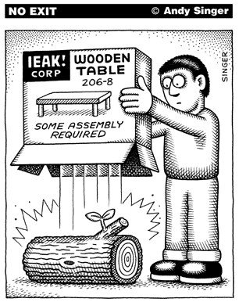
Assembly Programs
http://www.andysinger.com/

Slide 3
Why do we learn Assembly?
Assembly isn’t “just another language”.
Help you understand how does the processor work
Assembly program runs faster than high-level language. Performance critical codes must be written in assembly.
Use the profiling tools to find the performance bottle and rewrite that code section in assembly
Latency-sensitive applications, such as aircraft controller
Standard C compilers do not use some operations available on ARM processors, such ROR (Rotate Right) and RRX (Rotate Right Extended).
Hardware/processor specific code,
Processor booting code
Device drivers
A test-and-set atomic assembly instruction can be used to implement locks and semaphores.
Cost-sensitive applications
Embedded devices, where the size of code is limited, wash machine controller, automobile controllers
The best applications are written by those who've mastered assembly language or fully understand the low-level implementation of the high-level language statements they're choosing.

Slide 4
Character String
Memory Address | Memory Content | Letter
str + 12→ | 0x00 | \0
str + 11→ | 0x79 | y
str + 10→ | 0x6C | l
str + 9→ | 0x62 | b
str + 8→ | 0x6D | m
str + 7→ | 0x65 | e
str + 6→ | 0x73 | s
str + 5→ | 0x73 | s
str + 4→ | 0x41 | A
str + 3→ | 0x20 | space
str + 2→ | 0x4D | M
str + 1→ | 0x52 | R
str → | 0x41 | A
char str[13] = “ARM Assembly”;
Big Endian or Little Endian?

Slide 5
Data Representation
Integers
Binary in different bases: binary, octal, hex, decimal
Signed Integers
Two’s complement
Arithmetic Operations
NVCZ flags
Big Endian vs Little Endian
ASCII values
Null-terminated string
Converting between numbers and ASCII
Upper case, lower case
Fixed point numbers
Qm.n, UQm.n
Addition, subtract, multiplication, division
Floating point numbers
IEEE 754 Standard
Single Precision, Double Precision

Slide 6
Basic Assembly Programming
Load-modify-store sequence
Accessing memory
Memory addressing mode
Pre-index
Post-index
Pre-index with update
Data processing
Arithmetic, Logic, Comparison, Data Movement
Barrel Shifter:
ADD r1, r0, r0, LSL 2
Bit operations
Set a bit, Reset a bit, Toggle a bit, Check a bit
LSL, LSR, ASR, ROR, RRX
Flow control: if, if-then-else, for loop, while loop
Unconditional Branch: B
Conditional Branch: CMP, TEQ,TST, BEQ, BNE, BMI, BLS, BHI, etc.
Conditional Execution: MOVEQ, MOVNE

Slide 7
Subroutine Without Floating Numbers
Calling Subroutine & Exiting Subroutine
BL and BX
How are PC, LR, and SP registers updated?
Caller-saved registers:
R0–R3: Arguments/return registers.
R12 (IP): Intra-procedure scratch register.
CPSR: — caller must preserve its state if needed.
Callee-saved registers:
R4–R11: Must be saved/restored by the callee if used.
R14 (LR): Must be saved if the callee makes nested calls.
R13 (SP): Stack pointer — must be preserved.
Extra parameters passed on stack:
When more than four arguments exist.
Return value in R0
Recursive functions
How does the stack work?
Pay special attention to LR register
Notes:
Save and restore R4-R11,LR if your subroutine wishes to modify
Parameters passing in registers R0, R1, R2, R3
Extra parameters passing in stack
Return parameter in R0

Slide 8
Subroutine with Float/Double Arguments
Each number is assigned in turn to the next free register of the corresponding type
Example:
double fun(double a1, float a2, double a3, float a4, float a5, double a6, float a7, double a8)

Slide 9


Interrupt
Interrupt vs Polling
Interrupt Service Routine
Interrupt Enable and Disable
Interrupt Stacking and Unstacking
Eight registers (R0-R3, R12, LR, PC, PSR) are automatically pushed into the stack before the hander starts
These registers are automatically popped when exiting the handler
http://www.istockphoto.com/

Slide 10
Stacking & Unstacking
Interrupt
Exit
Interrupt Handler
Interrupt
Signal
Unstacking
User Program
User Program
Stacking
Time
Thread Mode
Handler Mode
Thread Mode

Slide 11
Stacking & Unstacking
Old SP
SP + 0x20 | xxxxxxxx
SP + 0x1C | xPSP
SP + 0x18 | PC (r15)
SP + 0x14 | LR (r14)
SP + 0x10 | r12
SP + 0x0C | r3
SP + 0x08 | r2
SP + 0x04 | r1
SP + 0x00 | r0
The processor automatically pushes these eight registers into the main stack before an interrupt handler starts
The processor automatically pops these eight register out of the main stack when an interrupt hander exits.
Stack descends.
New SP
Two SPs: Main SP (MSP) and Process SP (PSP)
Determined by operating mode, and CONTROL[0]
Thread mode ⟶ SP = PSP
Handler mode ⟶ SP = MSP if CONTROL[0] = 0; Otherwise SP = PSP

Slide 12
Mixing C and Assembly
Accessing C variables
Struct & Data alignment
Static variables
Inline Assembly
C calling assembly functions
C: extern assembly functions and variables
Assembly: Export
Assembly calling C functions
Assembly: Import C function and variables
Export variables to C functions

Slide 13
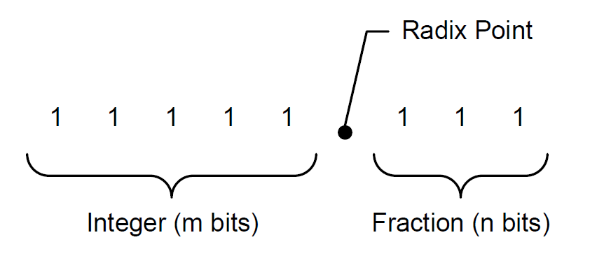
Unsigned Fixed-point Representation UQm.n
$$f=A_{h}+A_{l}×2^{−n}$$
$$10101.101_{2 }= A_{h}+A_{l}×2^{−3}$$
$$=21+5×2^{−3}$$
$$=21.625$$

Slide 14
Signed Fixed-point Representation Qm.n
$$A=−1×b_{N−1}×2^{N−1}+\sum_{i=0}^{N−2}{\left(b_{i}×2^{i}\right)}$$
$$f=\frac{A}{2^{n}}$$
where $N=m+n+1$

Slide 15
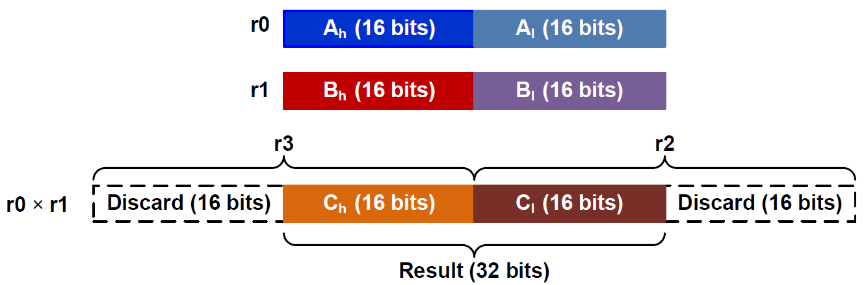
Fixed-point Multiplication in Q15.16
; r0 = fixed-point number A
; r1 = fixed-point number B
; r4 = fixed-point product = A × B
SMULL r2, r3, r0, r1 ; Unsigned long multiply
; r2 = low word, r3 = high word
LSLS r3, r3, #16 ; Shift left high word
LSRS r2, r2, #16 ; Shift right low word
ORR r4, r2, r3 ; Pack two halfwords into a word

Slide 16
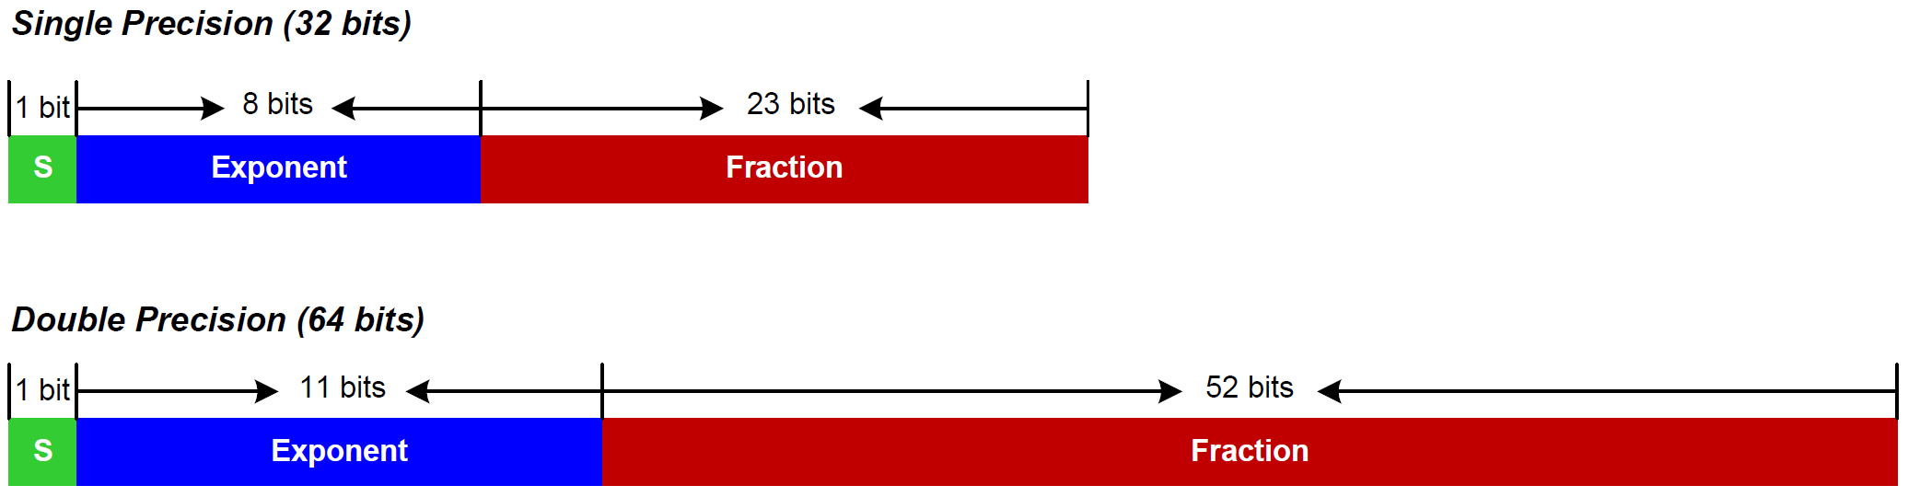
IEEE Std 754
IEEE 754 value:
$${(−1)}^{S}×(1+Fraction)×2^{Exponent−Bias}$$
where Bias = 127 for single precision
Bias = 1023 for double precision

Slide 17
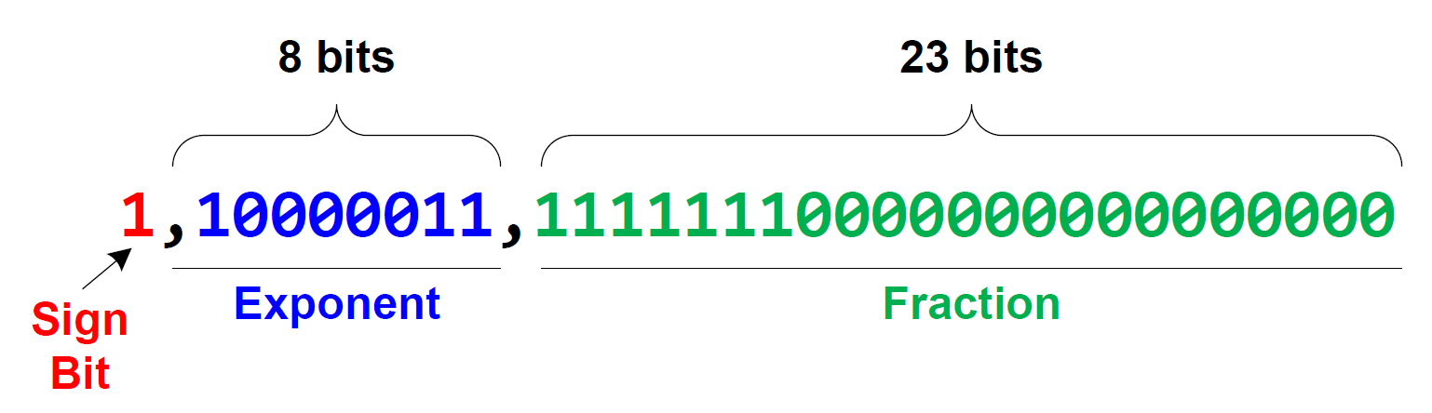
Decoding 0xC1FF0000 into a floating-point number
0.9921875
$$f={\left(−1\right)}^{S}×\left(1+Fraction\right)×2^{Exponent−127} \\ ={\left(−1\right)}^{1}×\left(1+0.9921875\right)×2^{131−127} \\ =−1×1.9921875×2^{4} \\ =−31.875$$

Slide 18
Encoding 14.5 into IEEE Std 754 Single-Precision
Normalization:
$$14.5=1.8125×2^{3}$$
$$=(1+0.8125)×2^{3}$$
$Sign=0$
$Exponent=3+127=130={1000010}_{2}$
$Fraction={0.1101}_{2}$
$0.8125×2=1.625=1+0.625$
$0.625×2=1.25=1+0.25$
$0.25×2=0.5=0+0.5$
$0.5×2=1$
14.5 = 01000001011010000000000000000000 in binary or 0x41680000 in hex

Slide 19
Timer’s Clock
Reload Value
TIMx_ARR
Reload
f_{CL_PSC}
f_{CL_CNT}
TIMx_CNT
TIMx_PSC
ISR
Resume
Interrupt
clock
Prescaler
Current Count
$$f_{CK_CNT}=\frac{f_{CL_PSC}}{Prescaler+1}$$

Slide 20
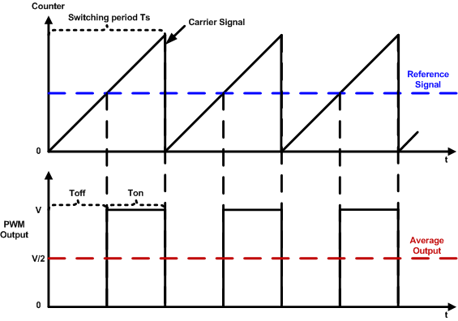
PWM Duty Cycle = T_{on}/Time Period
$$duty cycle=\frac{pulse on time}{pulse switching period}×100\%=\frac{T_{on}}{T_{s}}×100\%$$

Slide 21
Deleted

Slide 22
Down-counting Mode Illustration

